Slide 1
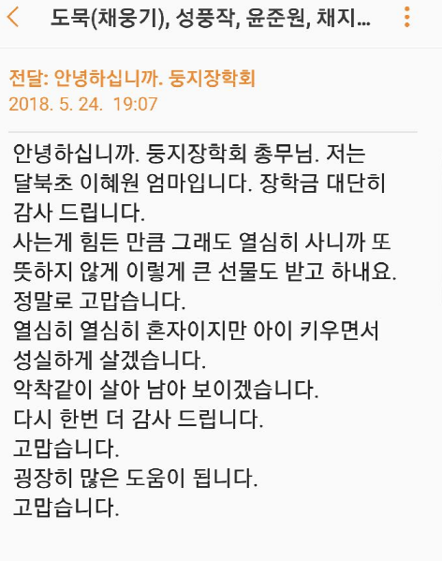

$$♦♦♦$$

Slide 2












